Slide 1
Analysis of Algorithmic Efficiency, Part II

Slide 2
Announcement
No office hours this afternoon
Lab today: the “Your Turn” problems
Will be graded on effort, not correctness
Full credit for making a full attempt at all 7 problems.

Slide 3
Two Phases of Analysis
Create a formula relating input size (n) to number of basic operations.
Formally prove that formula from step 1 belongs to a particular asymptotic class, Θ(n).

Slide 4
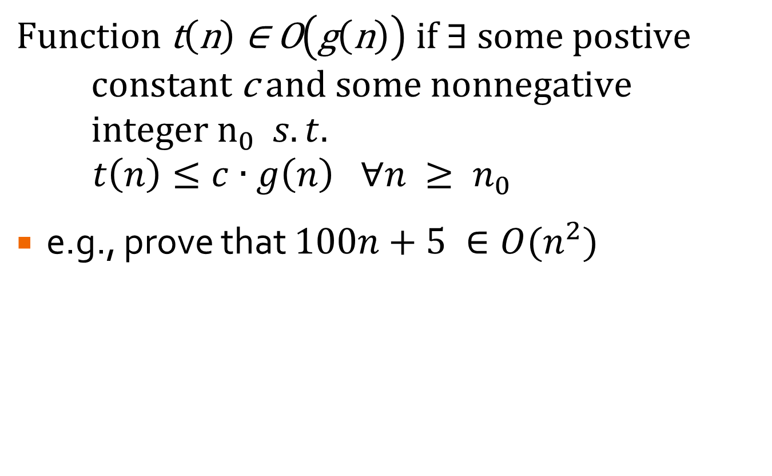
O-Notation (formal)
$$\text{Function} \text{t}\left(\text{n}\right) \text{∈ }\text{O}\left(\text{g}\left(\text{n}\right)\right) \text{if}\text{ ∃ }\text{some} \text{postive} \text{constant} \text{c} \text{and} \text{some} \text{nonnegative} \text{integer} n_{0} s.t.$$
$$t\left(n\right)≤c∙g\left(n\right) ∀n ≥ n_{0}$$
e.g., prove that $100n+5 ∈O(n^{2})$

Slide 5
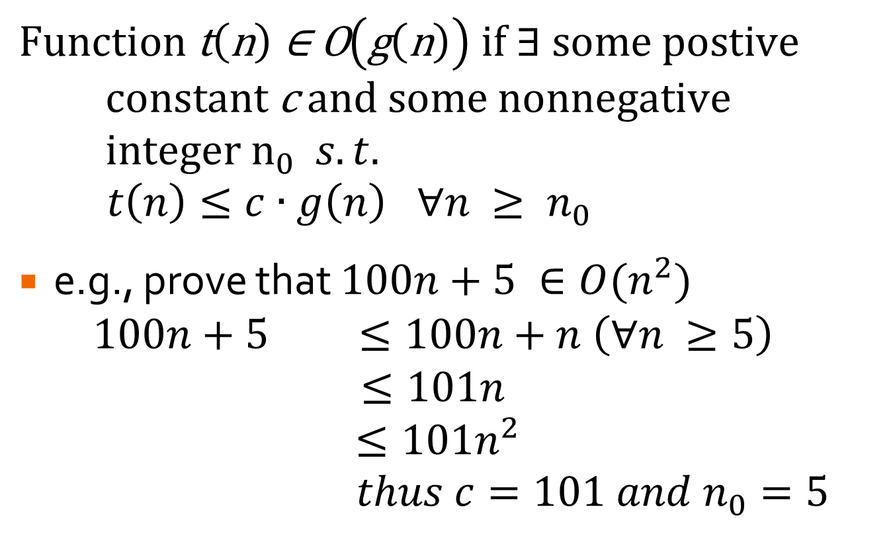
O-Notation (formal)
$$\text{Function} \text{t}\left(\text{n}\right) \text{∈ }\text{O}\left(\text{g}\left(\text{n}\right)\right) \text{if}\text{ ∃ }\text{some} \text{postive} \text{constant} \text{c} \text{and} \text{some} \text{nonnegative} \text{integer} n_{0} s.t.$$
$$t\left(n\right)≤c∙g\left(n\right) ∀n ≥ n_{0}$$
e.g., prove that $100n+5 ∈O(n^{2})$
$$100n+5 ≤100n+n \left(∀n ≥5\right)$$
$$≤101n$$
$$≤101n^{2}$$
$$thus c=101 and n_{0}=5$$

Slide 6

O-Notation (formal)
$$\text{Function} \text{t}\left(\text{n}\right) \text{∈ }\text{O}\left(\text{g}\left(\text{n}\right)\right) \text{if}\text{ ∃ }\text{some} \text{postive} \text{constant} \text{c} \text{and} \text{some} \text{nonnegative} \text{integer} n_{0} s.t.$$
$$t\left(n\right)≤c∙g\left(n\right) ∀n ≥ n_{0}$$
e.g., prove that $100n+5 ∈O(n^{2})$
$$100n+5 ≤100n+5n \left(∀n ≥1\right)$$
$$≤105n$$
$$≤105n^{2}$$
$$thus c=105 and n_{0}=1$$
Many possible values satisfy.

Slide 7



Your Turn …
Prove that $10n+1$ is in O(n).
$$10n+1$$
$$c_{0}∙n^{}$$

Slide 8



Your Turn …
Prove that $\frac{3n^{3}+6n^{2}+3n}{3n}$ is in O(n²).
$$\frac{3n^{3}+6n^{2}+3n}{3n}$$
$$c_{0}∙n^{2}$$

Slide 9

Ω-Notation (formal)
$$\text{Function} \text{t}\left(\text{n}\right) \text{∈} \text{Ω}\left(\text{g}\left(\text{n}\right)\right) \text{if}\text{ ∃ }\text{some} \text{postive} \text{constant} \text{c} \text{and} \text{some} \text{nonnegative} \text{integer} n_{0} s.t.$$
$$t\left(n\right)≥c∙g\left(n\right) ∀n ≥ n_{0}$$
e.g., prove that $100n^{3}+5n^{2} ∈\text{Ω}(n^{2})$

Slide 10
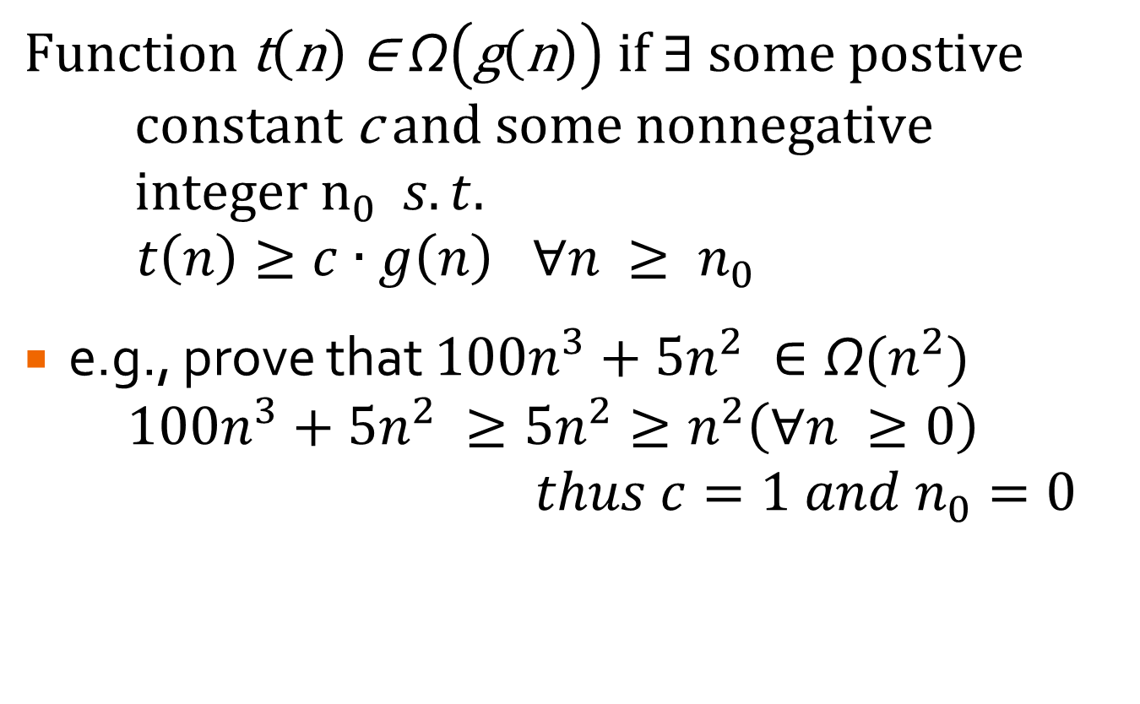
Ω-Notation (formal)
$$\text{Function} \text{t}\left(\text{n}\right) \text{∈} \text{Ω}\left(\text{g}\left(\text{n}\right)\right) \text{if}\text{ ∃ }\text{some} \text{postive} \text{constant} \text{c} \text{and} \text{some} \text{nonnegative} \text{integer} n_{0} s.t.$$
$$t\left(n\right)≥c∙g\left(n\right) ∀n ≥ n_{0}$$
e.g., prove that $100n^{3}+5n^{2} ∈\text{Ω}(n^{2})$
$$100n^{3}+5n^{2} ≥{5n}^{2}≥n^{2}\left(∀n ≥0\right)$$
$$thus c=1 and n_{0}=0$$

Slide 11
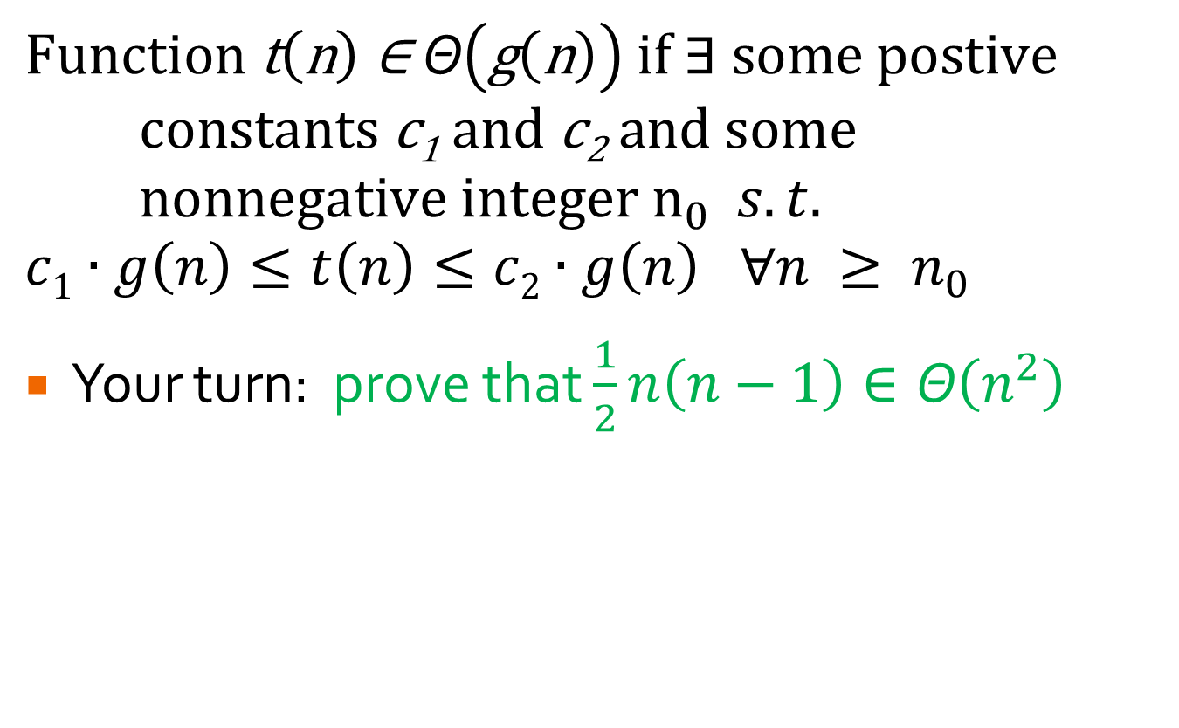
Θ-Notation (formal)
$$\text{Function} \text{t}\left(\text{n}\right) \text{∈} \text{Θ}\left(\text{g}\left(\text{n}\right)\right) \text{if}\text{ ∃ }\text{some} \text{postive} \text{constants} \text{c}\text{1} \text{and} \text{c}\text{2} \text{and} \text{some} \text{nonnegative} \text{integer} n_{0} s.t.$$
$$c1∙g\left(n\right)≤t\left(n\right)≤c2∙g\left(n\right) ∀n ≥ n_{0}$$
Your turn: prove that $\frac{1}{2}n\left(n−1\right)∈\text{Θ}\left(n^{2}\right)$

Slide 12
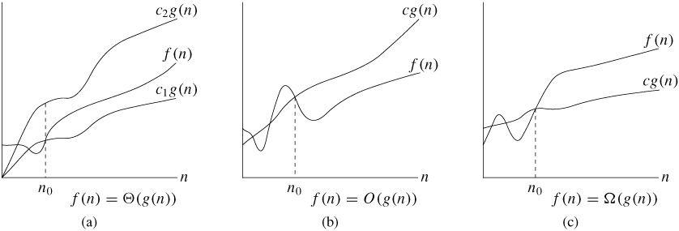
Visually…

Slide 13
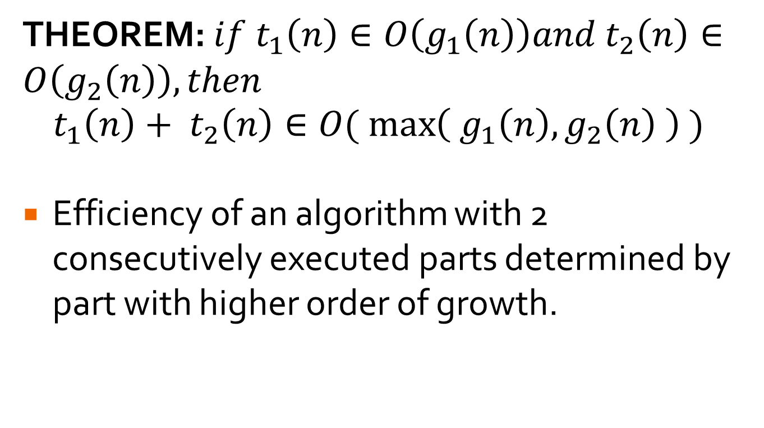
Useful Theorem
THEOREM: $if t_{1}\left(n\right)∈O\left(g_{1}\left(n\right)\right)and t_{2}\left(n\right)∈O\left(g_{2}\left(n\right)\right), then$
$$t_{1}\left(n\right)+ t_{2}\left(n\right)∈O(\max\left({ g}_{1}\left(n\right), g_{2}\left(n\right) \right) )$$
Efficiency of an algorithm with 2 consecutively executed parts determined by part with higher order of growth.

Slide 14

Limit Ratios
Alternative for proving order of growth:
$$\lim_{n→∞}{\frac{t(n)}{g(n)}=\left\{\begin{matrix}0 implies t\left(n\right)has smaller order of growth than g(n) \\ c implies t\left(n\right)has same order of growth as g\left(n\right) \\ ∞ implies t\left(n\right)has larger order of growth than g(n)\end{matrix}\right.}$$
Which bounds are implied by the 3 parts?
Notes:
First two cases, t(n) in O(g(n)). Last two cases, t(n) in omega(g(n))

Slide 15
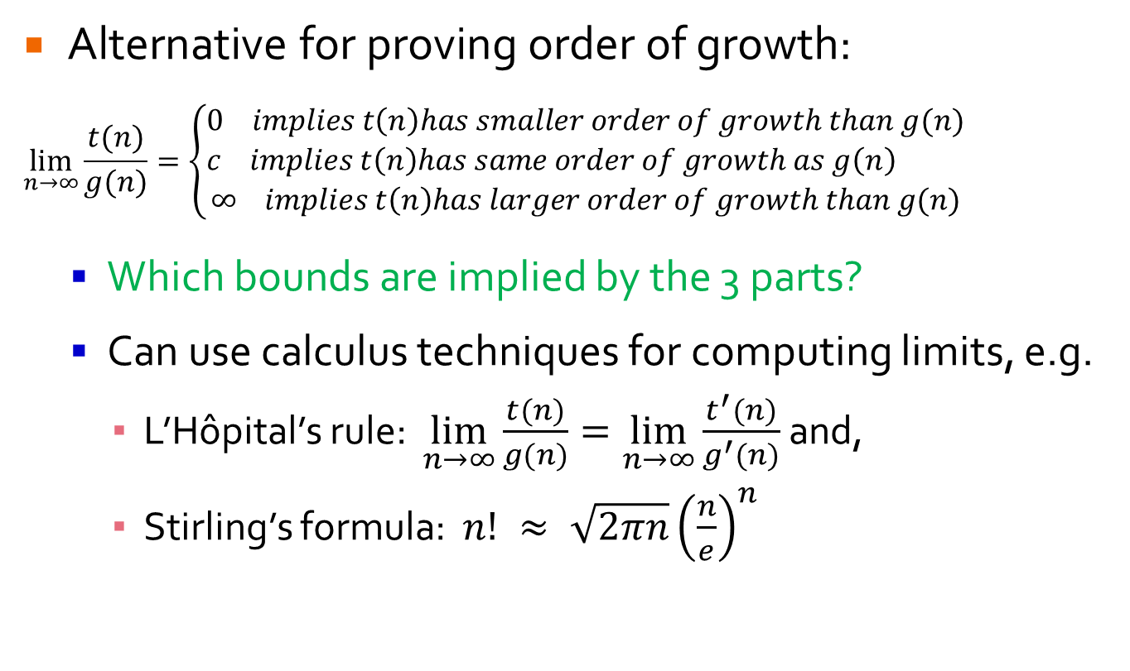
Limit Ratios
Alternative for proving order of growth:
$$\lim_{n→∞}{\frac{t(n)}{g(n)}=\left\{\begin{matrix}0 implies t\left(n\right)has smaller order of growth than g(n) \\ c implies t\left(n\right)has same order of growth as g\left(n\right) \\ ∞ implies t\left(n\right)has larger order of growth than g(n)\end{matrix}\right.}$$
Which bounds are implied by the 3 parts?
Can use calculus techniques for computing limits, e.g.
L’Hôpital’s rule: $\lim_{n→∞}{\frac{t(n)}{g(n)}=\lim_{n→∞}{\frac{t^{′}(n)}{g^{′}(n)} }}$and,
Stirling’s formula: $n! ≈ \sqrt{2πn}{\left(\frac{n}{e}\right)}^{n}$
Notes:
First two cases, t(n) in O(g(n)). Last two cases, t(n) in omega(g(n))

Slide 16

Limit Ratio Examples
$\lim_{n→∞}{\frac{\frac{1}{2}n(n−1)}{n^{2}}}$
$\lim_{n→∞}{\frac{\log_{2}{n}}{\sqrt{n}}}$
$\lim_{n→∞}{\frac{n!}{2^{n}}}$

Slide 17
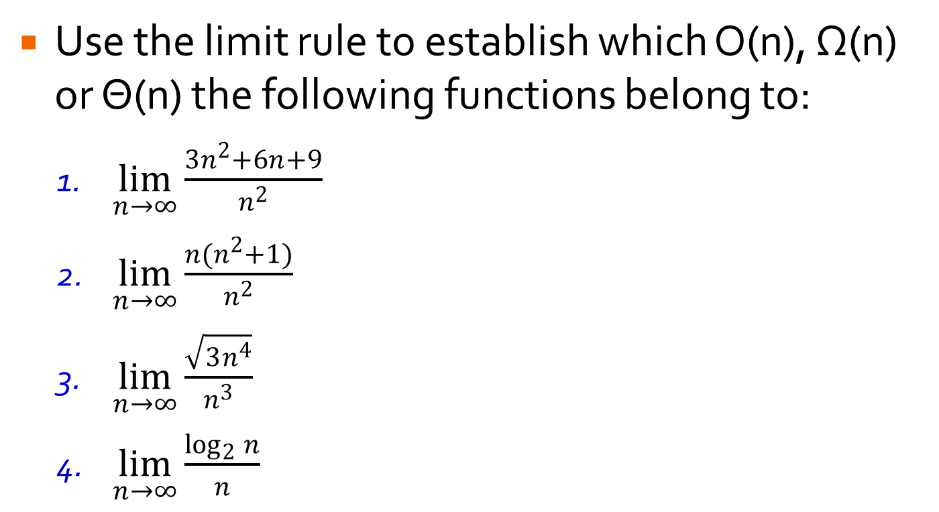
Your Turn …
Use the limit rule to establish which O(n), Ω(n) or Θ(n) the following functions belong to:
$\lim_{n→∞}{\frac{3n^{2}+6n+9}{n^{2}}}$
$\lim_{n→∞}{\frac{n(n^{2}+1)}{n^{2}}}$
$\lim_{n→∞}{\frac{\sqrt{3n^{4}}}{n^{3}}}$
$\lim_{n→∞}{\frac{\log_{2}{n}}{n}}$

